Slide 1

Exploratory Analysis of Grocery Store Data Using Market Basket Analysis.
GUIDE : Dr.Y.V.S.S. Pragathi
PROJECT BY :
160619733011- Reshmika Dhannarapu
160619733059- Vyshnavi Yelgoe
160619733044- Sreeja Sogala

Slide 2
Abstract
● Data Mining In Organisations.
● Advantages of Data Mining.
● Data Mining in Retail Stores.
● Market Basket Analysis.
● Association Rules.
● Our Model
Context

Slide 3
Introduction
● To understand the purchasing pattern of products that comprise the
customers’ basket.
● To study about many products usually purchased by the customers.
● To study the most likely products purchased by the customers along with a
particular product category.
● To help retailers recommend and suggest products to individual customers
Context

Slide 4
Literature Survey
● In recent decades, data mining have played a key role in marketing
literature.
● Market basket analysis is one of the oldest data mining areas, and the
best example of mining association rules.
● Researchers have developed several algorithms for the Rule Mining
Association to help users achieve their goals.
Context

Slide 5
Literature Survey
Context
●Title : Market Basket Analysis Using Apriori Algorithm In R Language
Authors: Nidhi Makarand Kawale, Dr. Snehil Dahima
❖proposed apriori algorithm which is one of the classical algorithms for finding frequent patterns for Boolean association rules.
❖The authors elaborate on the concept of mining quantitative rules in large relational tables.

Slide 6
Literature Survey
Context
●Title: Fast Algorithm for Mining Association Rules
Authors:Agrawal R. and Srikant R.
❖analyzed the percentage of customers’ purchasing a certain product and the percentage of all total sales generated by this product
❖ Another significant stream of research in the field of exploratory analysis is the process of generating association rules.

Slide 7
Literature Survey
●Title: Data Mining Techniques for Marketing, Sales and Customer Relationship Management
Authors:Berry and Linoff
❖Targeted on discovering getting patterns by extracting associations or co-occurrences from a store’s transactional information. Customers who purchase bread often also purchase several products related to bread like milk, butter or jam. Such related groups of products additionally should be placed side-by-side so as to remind customers of related products and to guide them through the centre in a very logical manner.
Context

Slide 8
Problem Statement
What are the frequent itemsets in a given transactional dataset, and how can this information be used to identify associations between items and make recommendations to customers?
What are the patterns and relationships present in a given dataset, and how can we use visualization and summary statistics to gain insights and make informed decisions?
Context

Slide 9
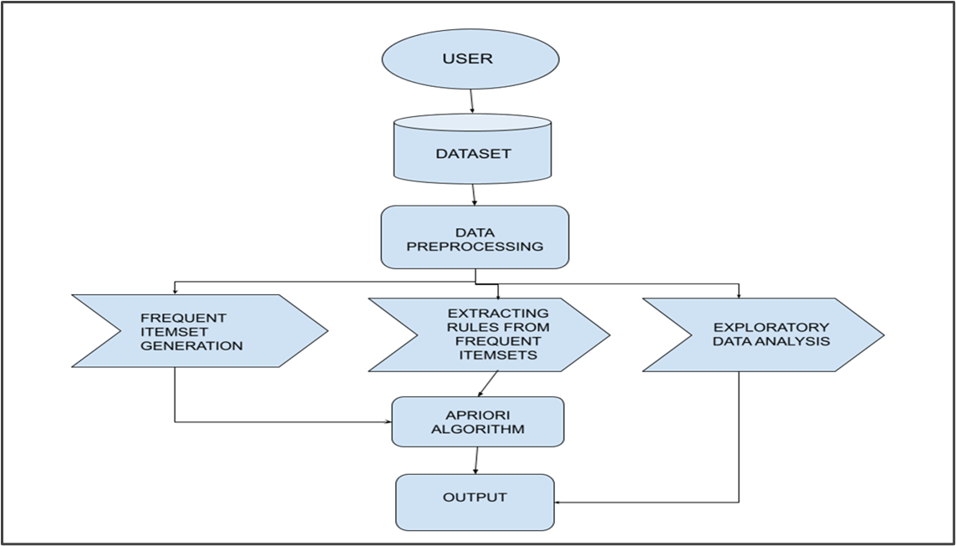
Architecture
Context

Slide 10
Methodology
- Problem Definition
- Data Collection
- Data Preprocessing
- Data Combining
- Exploratory Data Analysis
- Market Basket Analysis Using Apriori Algorithm
Context

Slide 11
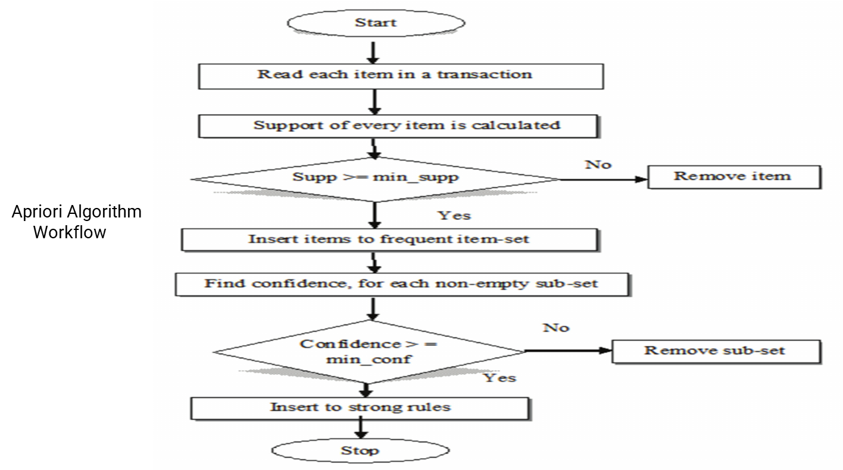
Context

Slide 12
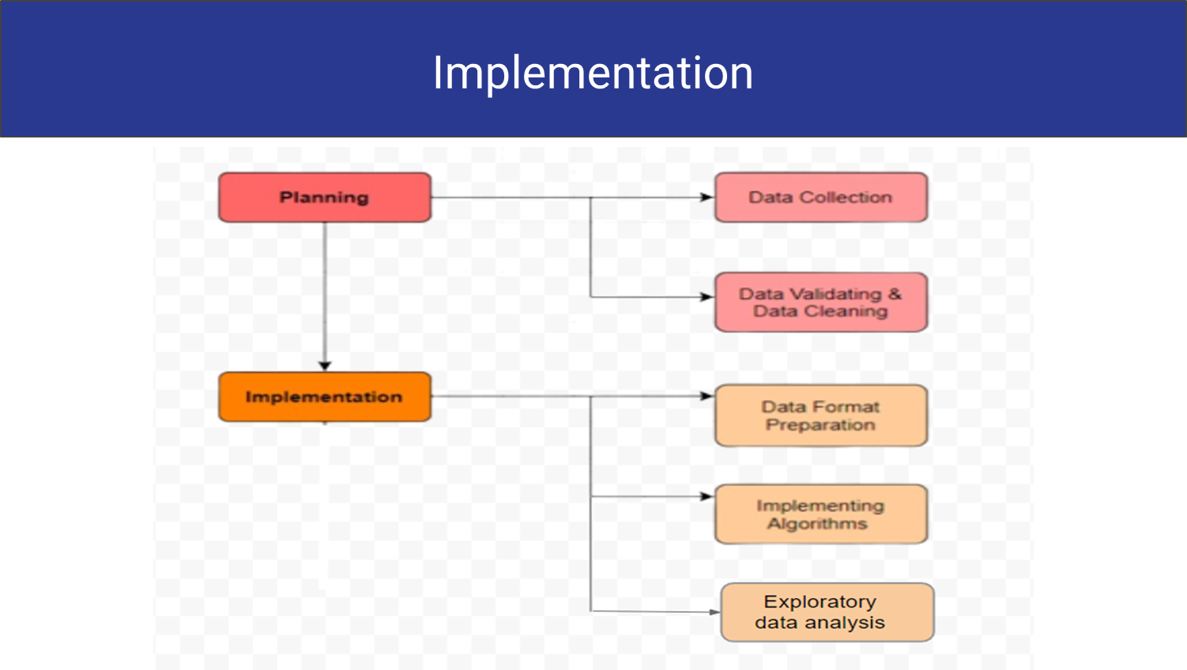
Context

Slide 13
Dataset
Instacart Dataset : Consists of csv files
Aisles : aisle_id , aisle_name
Departments : dept_id, dept_name.
Orders : ord_id, user_id, ord_no , ord_dayofweek, ord_hourofday, days_since_last_order.
Order_products_prior : ord_id , prd_id , add_to_cart_order, reordered.
Products: prd_id, prd_name, aidle_id, dept_id
Context

Slide 14
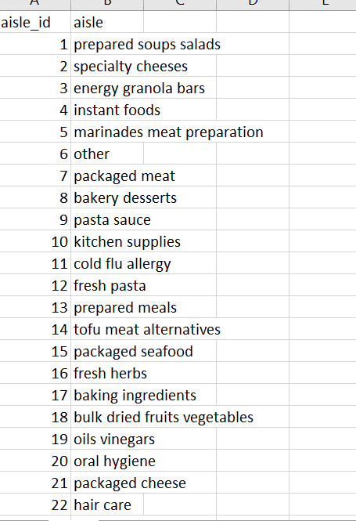
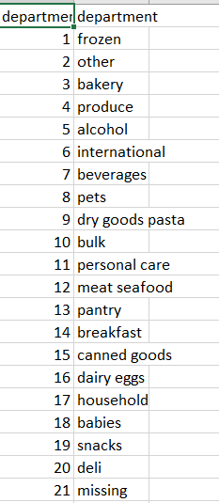
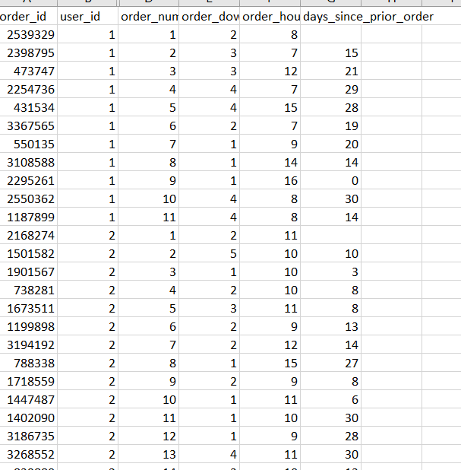
Dataset
Context

Slide 15
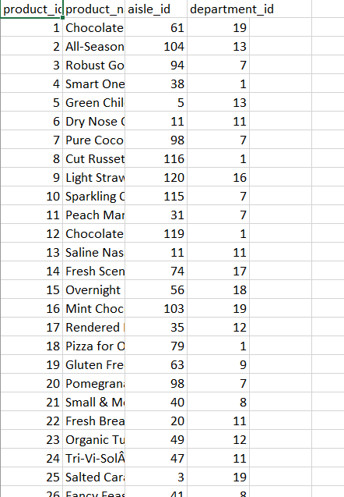
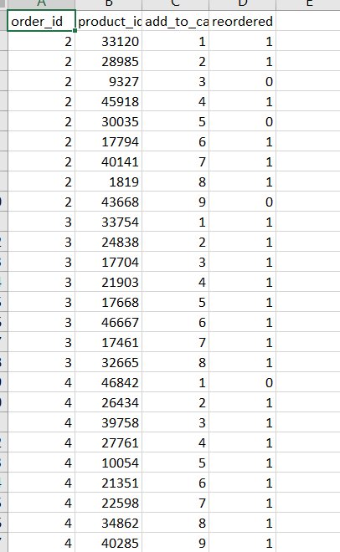
Dataset
Context

Slide 16
Data Preprocessing
Loading Dataset
Preparing dataset to perform data analysis :
Formatting files while reading - converting csv to dataframes
Merging multiple files - using joins
Deleting redundant data frames - to save memory
Data analysis with the processed data

Slide 17
Algorithm Justification
Apriori Algorithm for data mining:
Scalability
Flexibility
Interpretability
Wide-used

Slide 18
Impact of Algorithm
Ability to handle large datasets with many transactions with simplicity.
The algorithm's ability to efficiently identify frequent itemsets and generate association rules has made it a popular choice for a wide range of applications.
Impact on our project : It’s less complex to compute datasets like the instacart dataset and give out frequent itemsets and accurate association rules without much difficulty.

Slide 19
Project Specifications
Programming Language: Python
Packages :
Pandas
Numpy
mlxtend
Matplotlib
Networkx
Seaborn
Functools

Slide 20
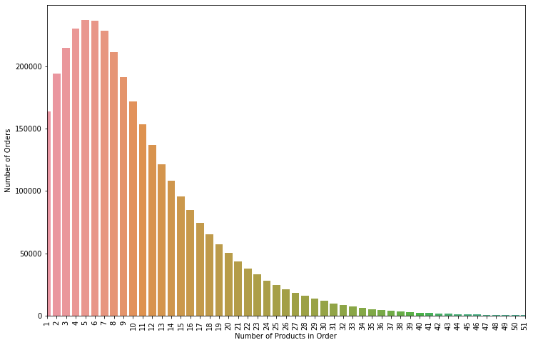
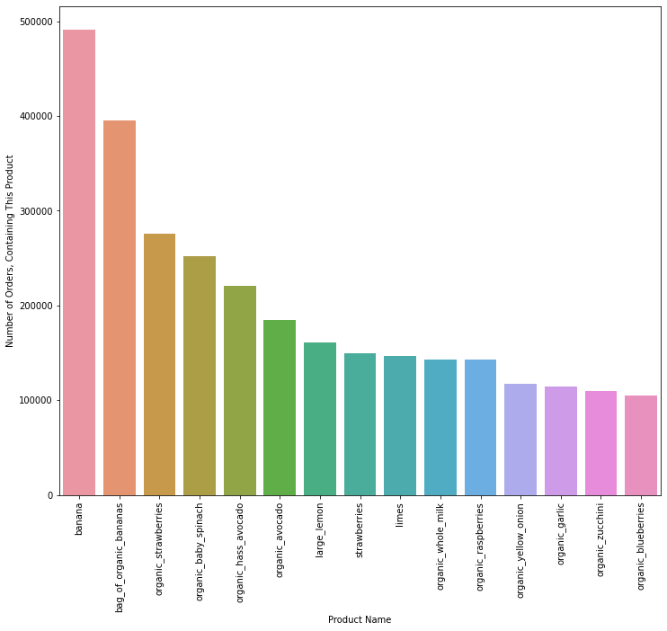
Results
Context

Slide 21
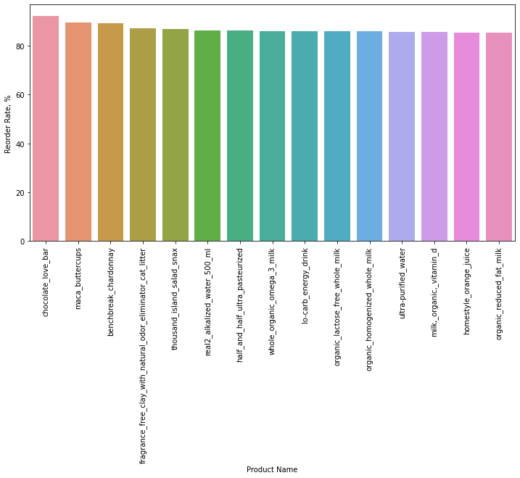
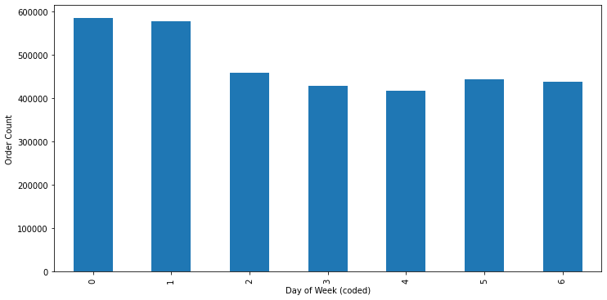
Results

Slide 22
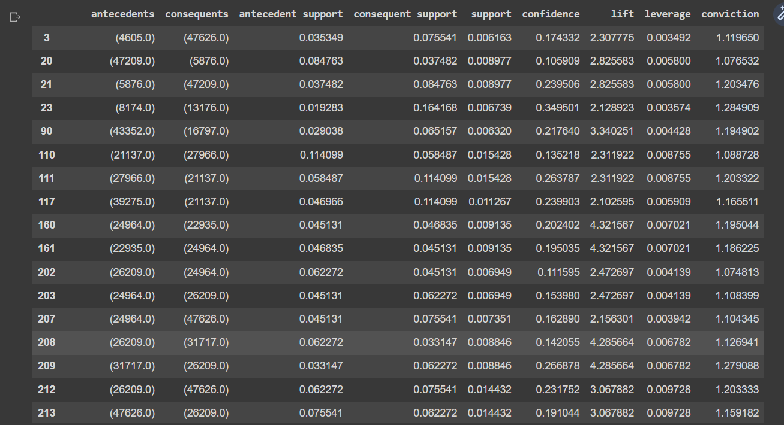
Results
RULES

Slide 23
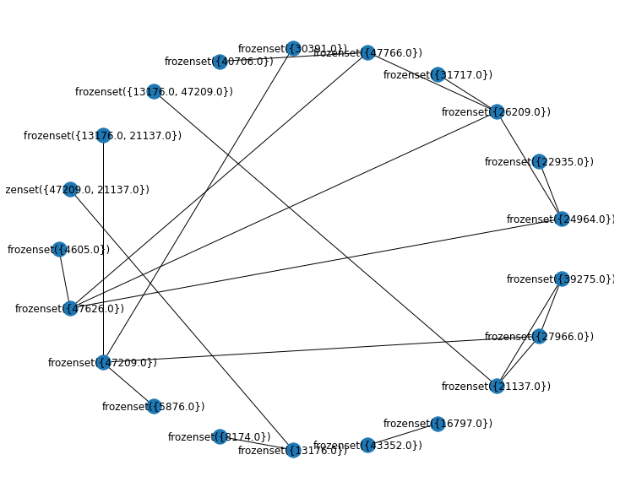
Results
RULES IN NETWORK FORM

Slide 24
Conclusion
Market Basket Analysis is a conceptual framework that originates in the marketing field and has been used effectively in fields such as bioinformatics, nuclear science, immunology, and geophysics more recently. One reason for MBA's increasing adoption across scientific fields is that by using an inductive approach to theorizing, researchers are able to evaluate the existence of association rules. Considering all, by summing up the whole, we agree that this model can have an efficient impact on marketing and sales research that can be used to make strategic business decisions.
Context

